Slide 1
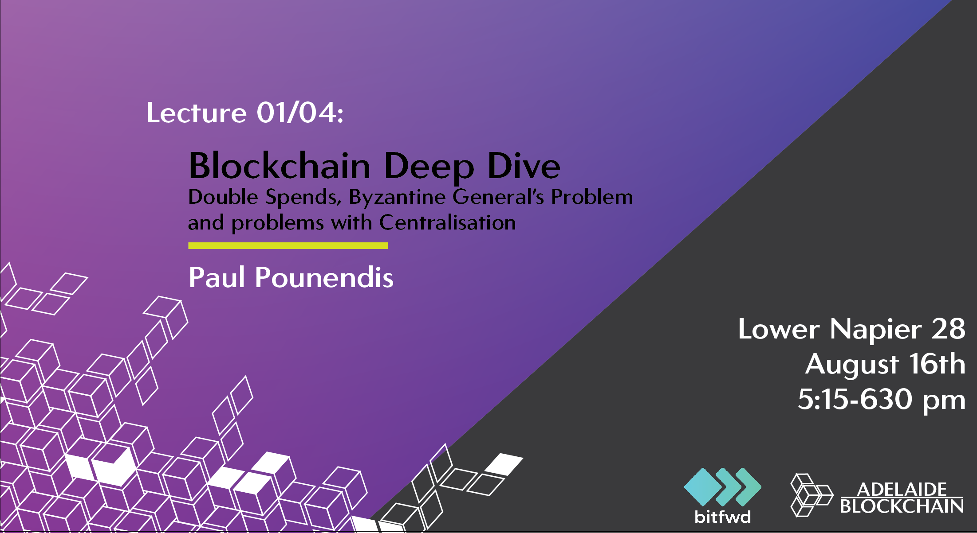
Lecture 01/04
1

Slide 2
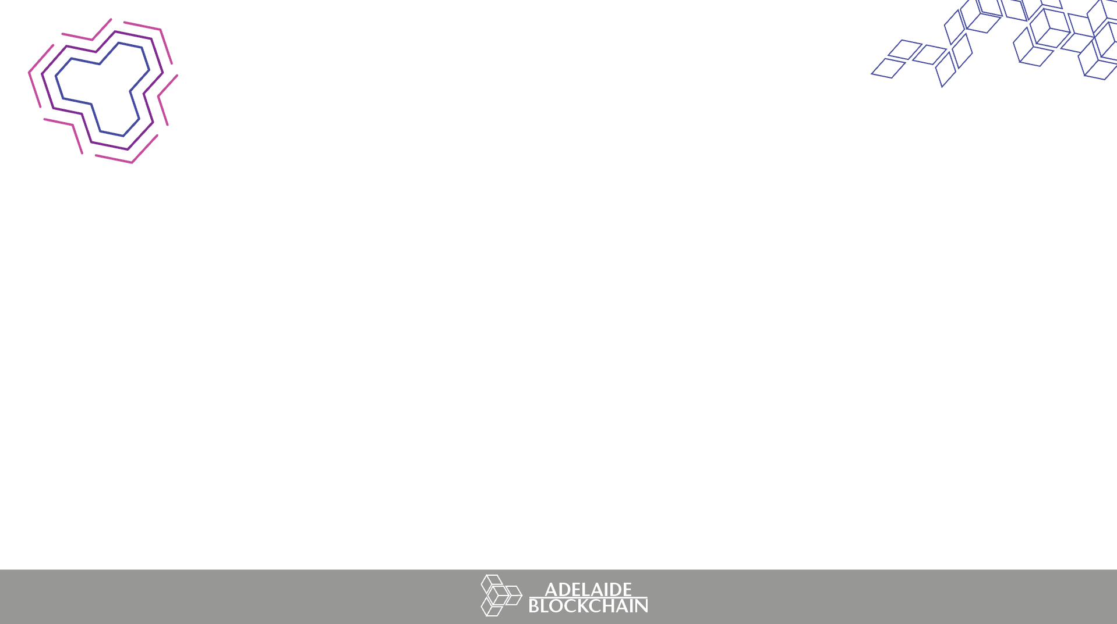


The economic case for Bitcoin
Introduction to Blockchain
Cryptography
Mining
Byzantine General’s problem and
Double Spends
1.
2

Slide 3




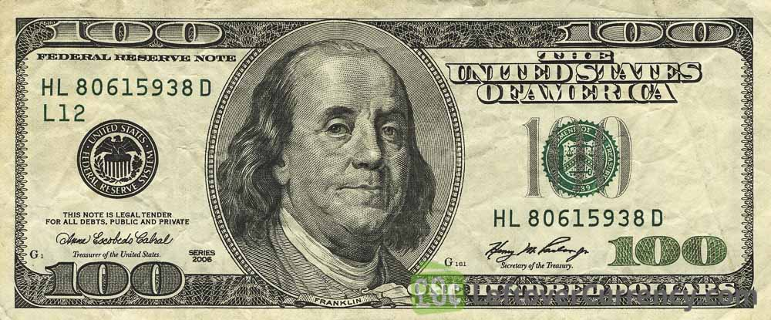

TYPES OF MONEY
3

Slide 4
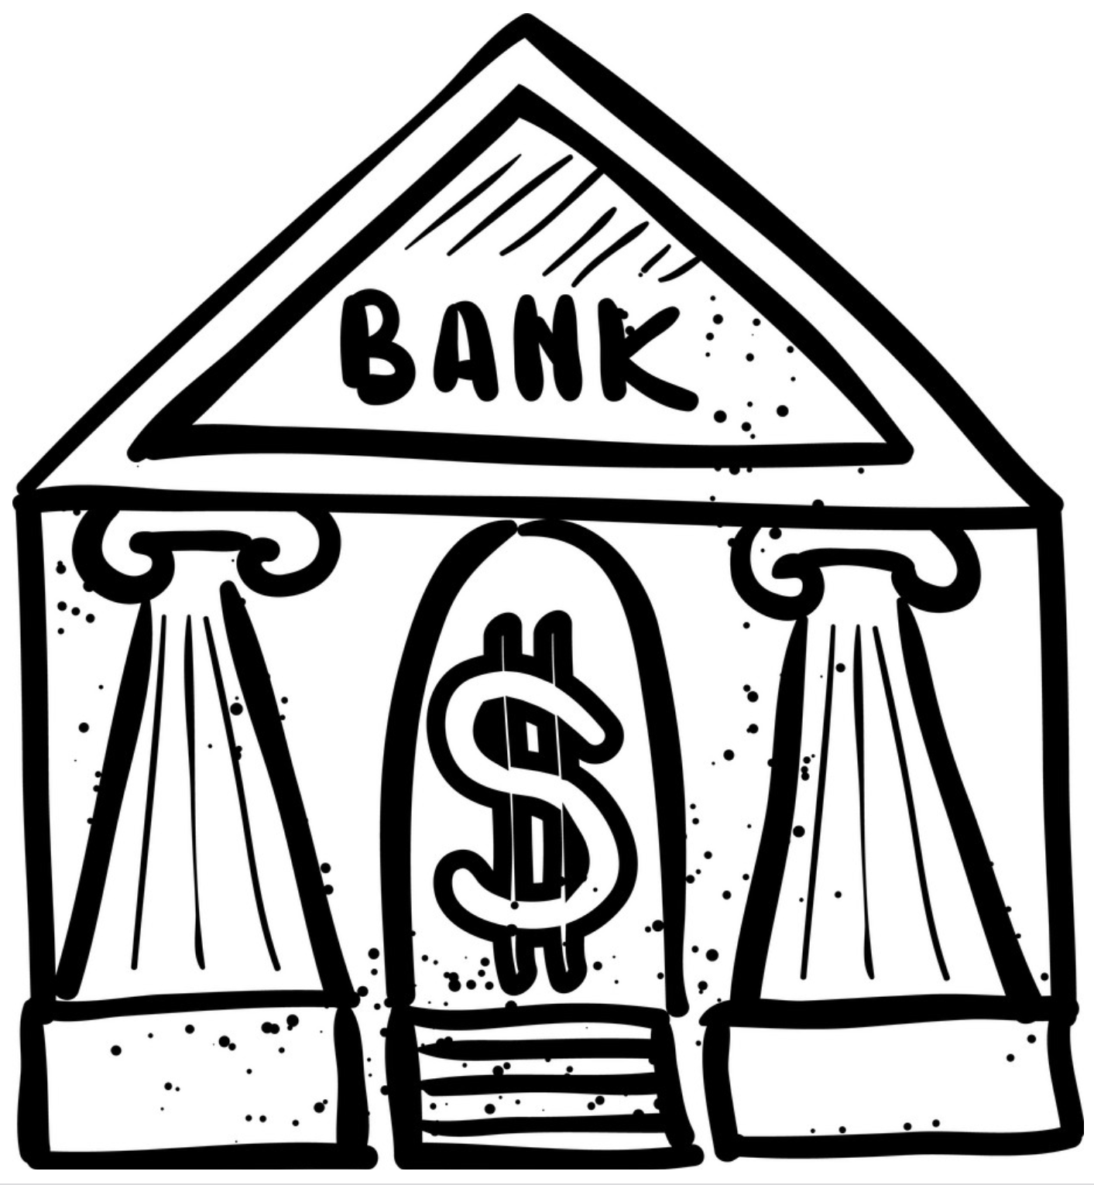


CENTRAL POINT OF FAILURE
4

Slide 5
CENTRAL POINT OF FAILURE
what could go wrong?
System failure
Rent seeking/high fees
Time cost
Human variability
Bank runs
Frozen assets
Seized assets
Fraud
Identity Theft
Hacking
Privacy breaches
5

Slide 6
INTEMEDIATION PROBLEMS
worldwide issues
1. Identity is required to create a bank account
Born in 3rd world country?
No birth certificate?
Cost to create an account?
Access to branch?
2. Currency inflation
Corrupt governments
Weak/unstable/vertical dependant economies?
Bad monetary Policy
Venezuela, Zimbabwe, Turkey
6

Slide 7
WHAT IS MONEY?
Measure of Value
- Use to compare value
Medium of Exchange
Liquidity
Divisibility and Fungibility
Storage of Value
Valued by users
Backed?
7

Slide 8
MONETARY SYSTEMS
the Gold Standard
Gold standard abolished
1933
Great Depression
Ties seized and cash injected
1971
Dollar-flushing removed
USD now a fiat currency
Fraction reserve banking
Capital holdings for liabilities drastically decreased
3. Is USD backed by anything?
8

Slide 9
MONETARY SYSTEMS
FIAT CURRENCIES
BUT, bitcoin value is derived by the CODED money supply
Block reward, 12.5 btc
Consensus determines monetary policy!
=
?
Well … no!
USD is legal tender, backed by the USD government
Backed by no asset!
Monetary policy of US government and public sentiment critical!
9

Slide 10
SOLUTION?
(The Blockchain’s first killer app!)
10

Slide 11
The economic case for Bitcoin
Introduction to Blockchain
Cryptography
Mining
Byzantine General’s problem and
Double Spends
2.
11

Slide 12
DECENTRALISED SOLUTION
how?
How do you replace a centralized authority?
How do you ensure sound money (no double spends)?
How do you get equal players to all reach consensus on a state of truth in distributed systems?
BYZANTINE GENERALS PROBLEM
We will get back to this …..
12

Slide 13
DECENTRALISED SOLUTION
Blockchain fundamentals
First truly decentralised, open-source, peer to peer currency (Bitcoin)
Sovereign-less, country-less; all you need is the internet!
Previous digital cash attempts failed due to centralisation!
- DigiCash, E-Gold etc
Many of the pitfalls of centralisation can be circumvented
Hacking; inconceivable amount of consistent computational power
Fraud; A transparent Blockchain with inherent privacy creates accountability and removes obsfucation
Asset sovereignty; assets can not be taken or frozen, only owners of private keys can access!
13

Slide 14
The economic case for Bitcoin
Introduction to Blockchain
Cryptography
Mining
Byzantine General’s problem and
Double Spends
3.
14

Slide 15
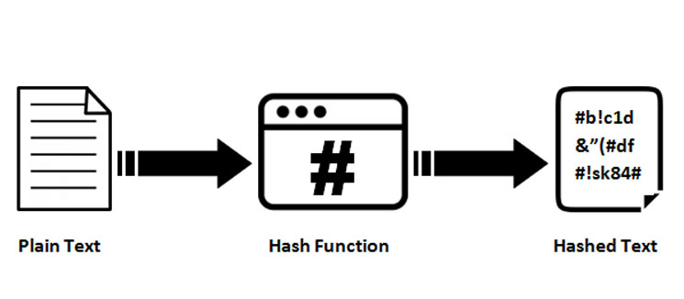
CRYPTOGRAPHIC PRIMITIVES
Cryptography and hash functions
CRYPTOGRAPHY
/krɪpˈtɒɡrəfi/
The protocols and processes of subverting 3rd parties from accessing data between channels of communication.
HASH FUNCTION PROPERTIES
Trapdoor functions
Output random no matter the input; deterministic and fixed length
Collision resistant; no two inputs have the same output
Verification only done through brute force or with access to input
15

Slide 16
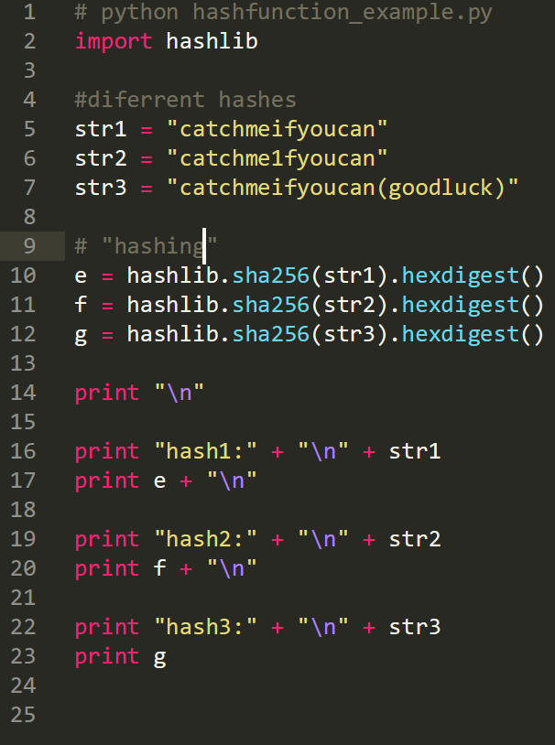
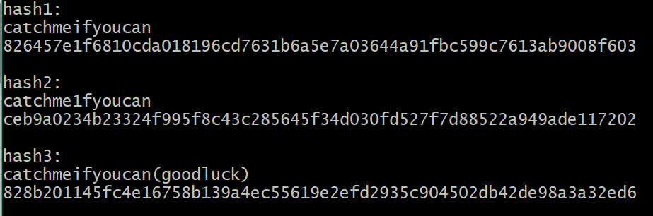
CRYPTOGRAPHIC PRIMITIVES
hash functions
MD5, SHA1, SHA2 etc
One small change in the input completely changes the output
16

Slide 17
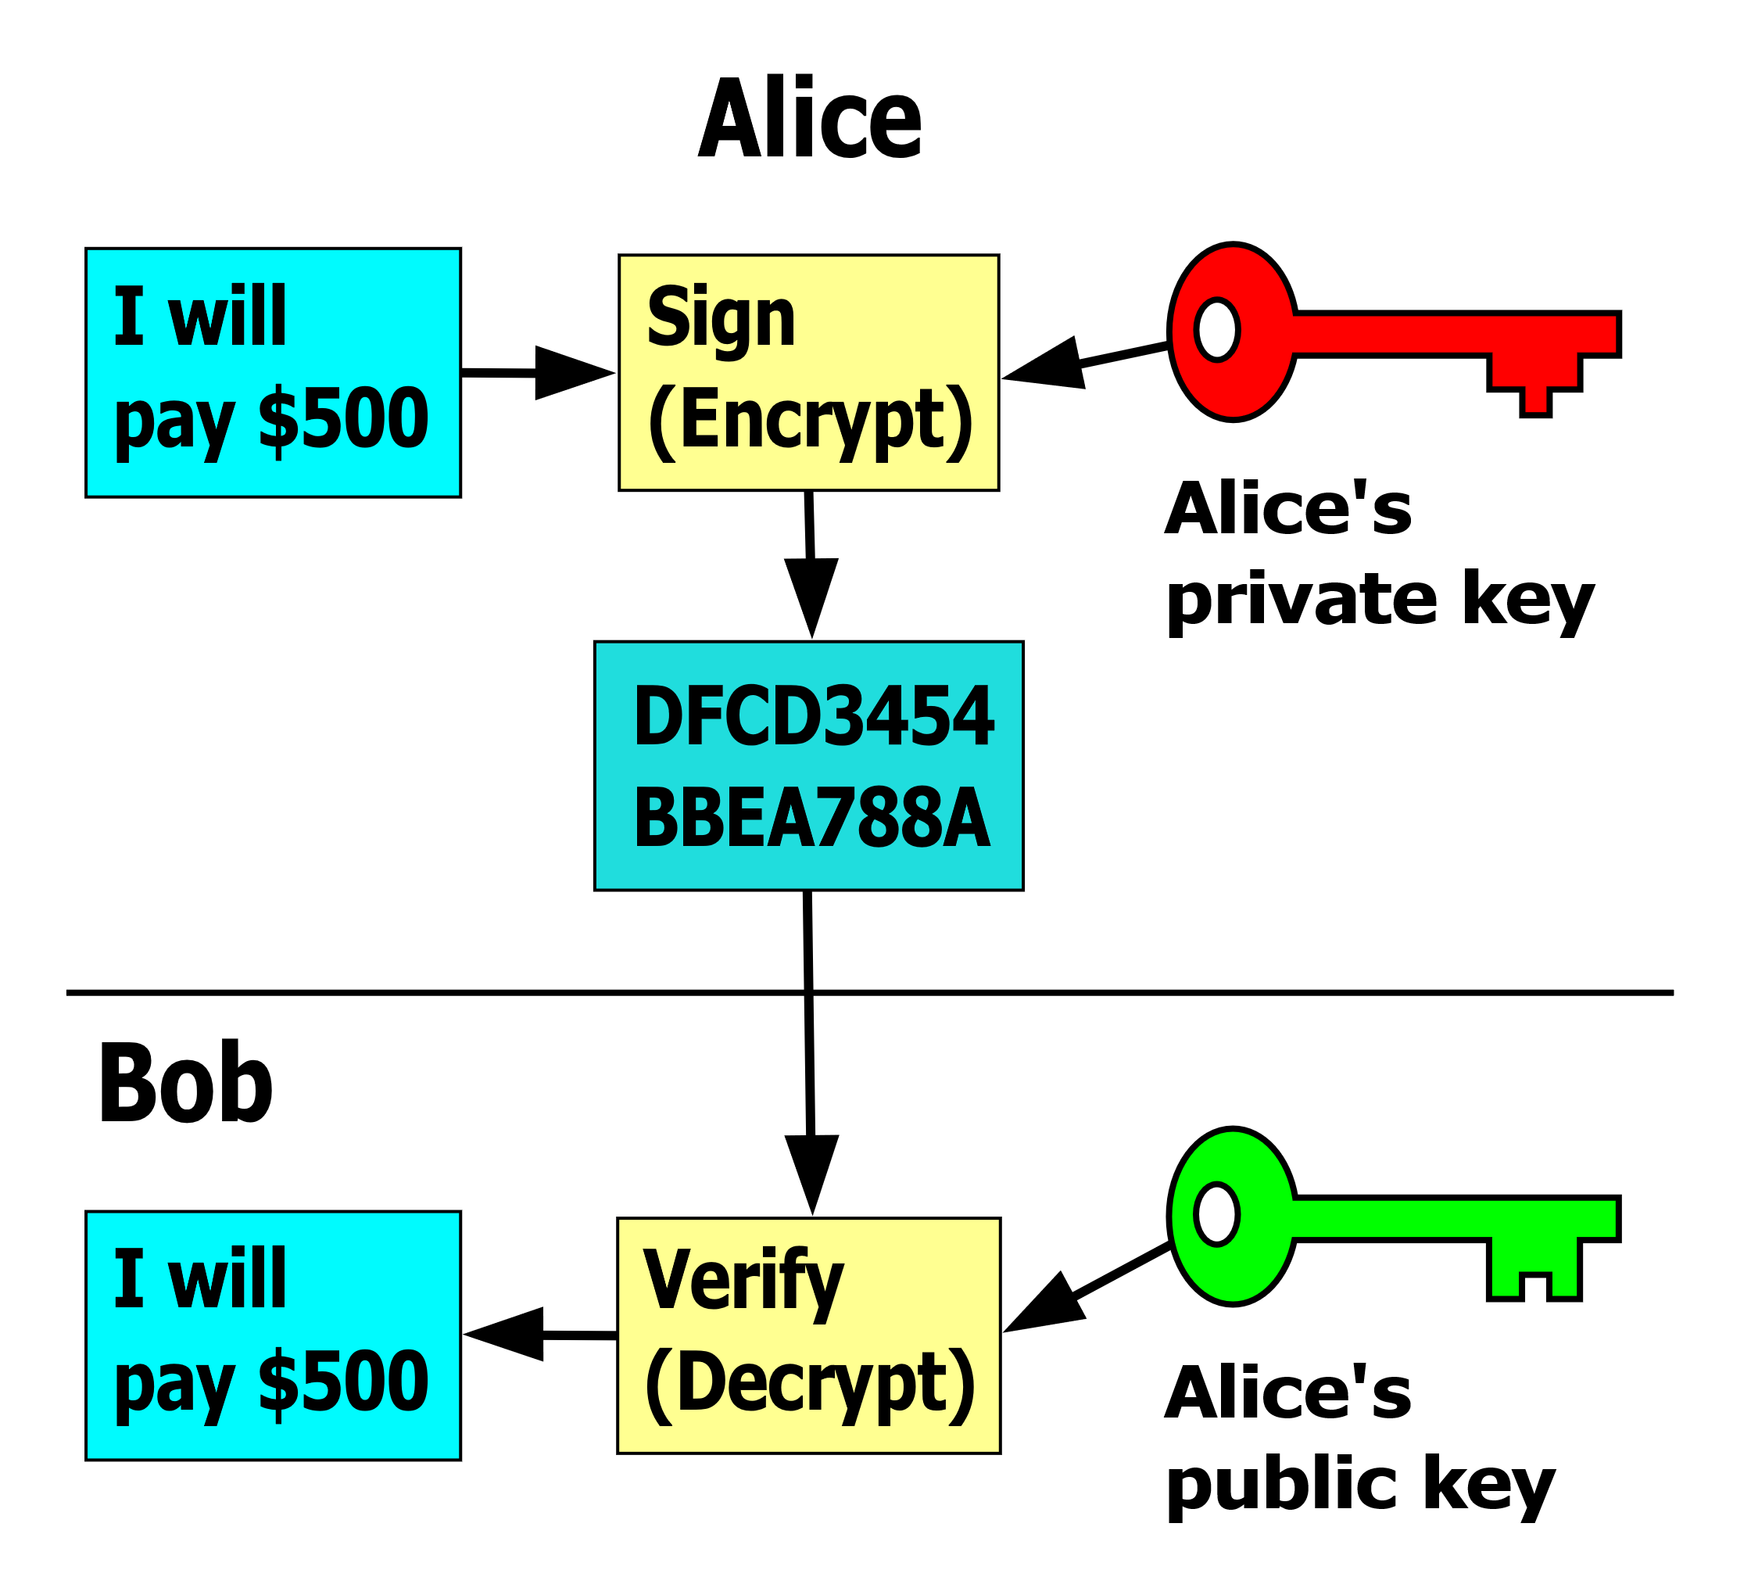
CRYPTOGRAPHIC PRIMITIVES
cryptography types
TYPES
Symmetric cryptography
Common key between sender/receiver
How to keep key inaccessible (physical limitations)?
Assymetric: Public/private key cryptography
Sender and receiver has different private keys
Public and Private keys necessarily related
Private key indecipherable from public key
Digital Signatures!
17

Slide 18



CRYPTOGRAPHIC PRIMITIVES
public/private key cryptography
Public/private key cryptography allows for transfer of encrypted data without needing to first have sender/receiver chose a shared private key.
PRIVATE KEY
PUBLIC KEY
BITCOIN ADDRESS
PubAddr = RIPEMD160(SHA256(PubKey))
Pubkey = k x G
Base58 Encoding
Elliptic Curve Multiplication
Hashing
18

Slide 19
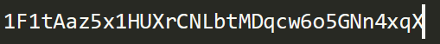
CRYPTOGRAPHIC PRIMITIVES
Bitcoin address: Identity
Bitcoin address acts as a form of “identity” for a participant
Blockchain tracking software and exchanges can attribute IP address
You can create as many public/private and bitcoin addresses as you want (wouldn’t recommend)
Very easy to lose track of all private keys
Blocking the Blockchain trail …
Bitcoin addresses aren’t necessarily attributed to a person.
AI algorithms and IoT devices can send bitcoin between each other.
19

Slide 20
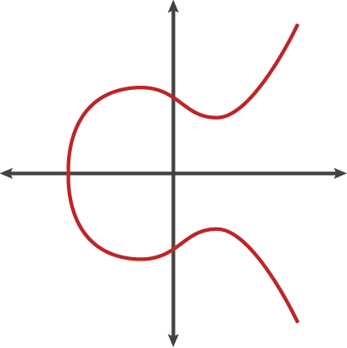
CRYPTOGRAPHIC PRIMITIVES
Digital Signatures
Digital analogue to an ordinary signature; signing off on transaction data
They prove the ownership of a private key, without revealing it!
Digital Signature properties
Authorization: Only the owner of the private key can create a signature that is correctly verifiable with the associated public key
Nonrepudiation: Once signed, the signature is undeniable.
Immutable: Once the signature is signed, is cannot be changed.
You only need the transaction data and the associated public key to verify a
Transaction!
The receiver must produce a signature with the transaction data and their private key to receive the bitcoin!
20

Slide 21
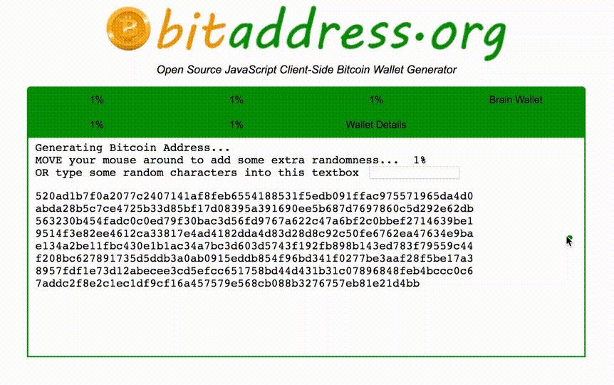
CRYPTOGRAPHIC PRIMITIVES
Entropy sources for privacy
Source of entropy incredibly important for private key randomness.
The whole point of cryptography is that it’s computationally infeasible to find a private key to a corresponding private key.
Don’t rely on seed values for language libraries!
Random key generator from mouse squiggle
Random key generator from atmospheric noise
21

Slide 22
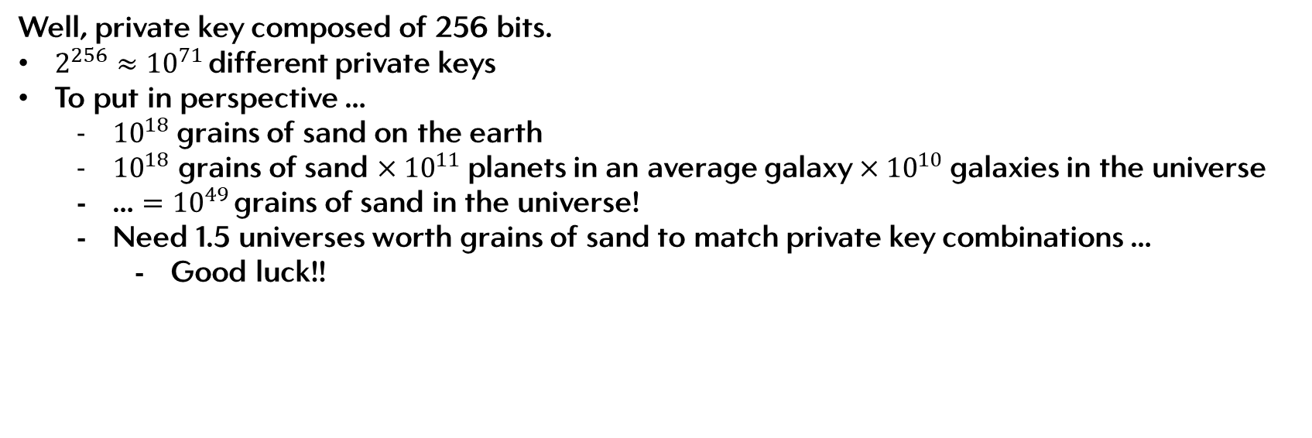
CRYPTOGRAPHIC PRIMITIVES
Hacking private keys
How hard is it really to brute force a private/public key pair?
Well, private key composed of 256 bits.
$2^{256}≈{10}^{71 }$different private keys
To put in perspective …
${10}^{18}$grains of sand on the earth
${10}^{18}$ grains of sand $×{10}^{11}$planets in an average galaxy $×{10}^{10}$galaxies in the universe
… $={10}^{49 }$grains of sand in the universe!
Need 1.5 universes worth grains of sand to match private key combinations …
Good luck!!
22

Slide 23
The economic case for Bitcoin
Introduction to Blockchain
Cryptography
Mining
Byzantine General’s problem and
Double Spends
4.
23

Slide 24
MINING?
Requirements
A “miner”, is a particular type of “node” in the network that is critically responsible for the Blockchain’s operations. It must:
Have a full copy of the Bitcoin Blockchain
Verify all incoming and past transactions by verifying digital signatures and assure no validity of all bitcoins
Collect valid transactions for the next “block”.
Find a solution to the SHA256 cryptographic puzzle by finding the correct input.
Hope that it’s the first miner to solve the puzzle, so it get’s accepted!
24

Slide 25
THE CRYTOGRAPHIC PUZZLE
SHA256
In order to win the cryptographic puzzle, the miner must find the right “input”.
The nonce
A 4 byte variable that is simply use for iteration (trial of new input)
Previous Block Hash
Previous block hash output
Merkle Root
A Merkle tree of all transactions within the given block
The target is defined by the “difficulty” of the required target. As the output is random given an input
25

Slide 26
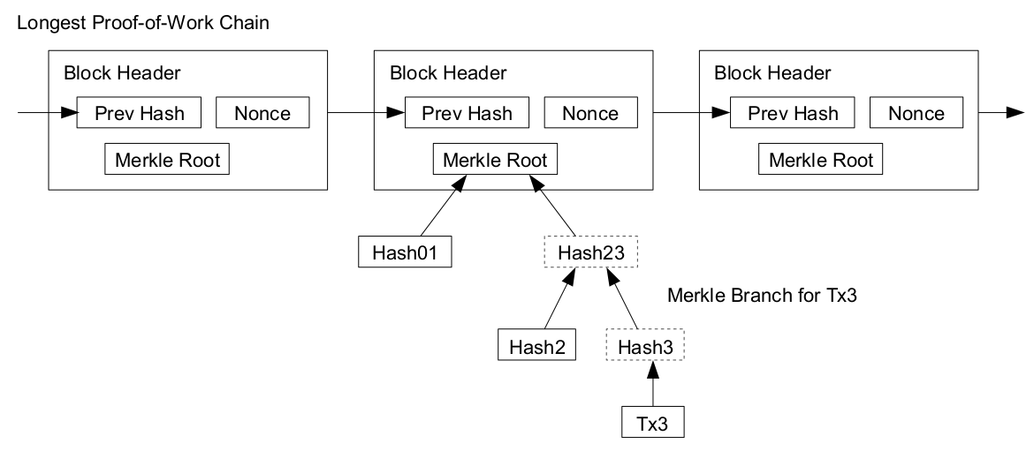
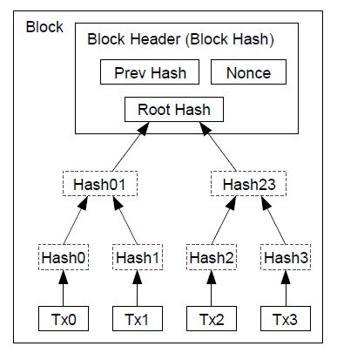
THE CRYTOGRAPHIC PUZZLE
Forming the header
YES!! The Blockchain is really just a linkedlist!
26

Slide 27
THE CRYTOGRAPHIC PUZZLE
Merkle Root
Each block consists of many transactions. The miner get’s to pick which transactions go in the block, and then place them into a Merkle tree.
They are able to also write a “coinbase” transaction”
The miner can write a transaction to itself, the cryptographic prize of bitcoin.
It will be accepted if the miner wins.
These transactions must valid and verified. If not, all other nodes will reject the block.
27

Slide 28
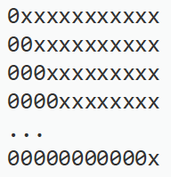

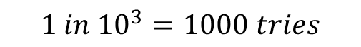

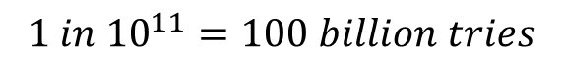
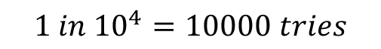
THE CRYTOGRAPHIC PUZZLE
Target Difficulty
In order to ensure on average some one finds a solution every 10 minutes, the output must be smaller then a target.
Every node automatically changes the difficulty itself according to the protocol rules in order to ensure each block is mined on average, every 10 minutes.
If node’s don’t comply, their mined block will be rejected by the network!
$$1 in {10}^{1}=10 tries$$
$$1 in {10}^{2}=100 tries$$
$$1 in {10}^{3}=1000 tries$$
$$1 in {10}^{4}=10000 tries$$
$$1 in {10}^{11}=100 billion tries$$
28

Slide 29
The economic case for Bitcoin
Introduction to Blockchain
Cryptography
Mining
Byzantine General’s problem and
Double Spends
5.
29

Slide 30
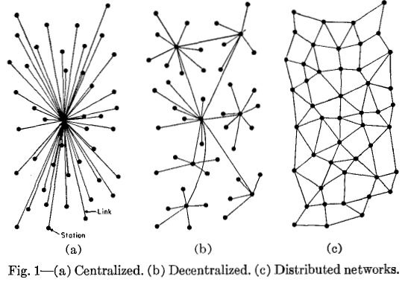
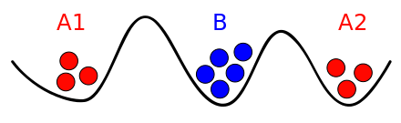
DECENTRALISED CONSENSUS
1. Two Generals Problem
Let’s explain by analogy:
- Two allies attacking a common enemy
How do they agree when to attack? (non-established attack window).
How do each know the other received the other’s confirmation letter?
Communication channels can be intercepted
Messages can be manipulated
30

Slide 31
DECENTRALISED CONSENSUS
2. Two Generals Problem
1
X
(LETTER 1) Jeff: Let’s attack August 16th, 6pm!
*Send’s letter to Stacey*
*Stacey receives*
(LETTER 2) Stacey: Ok, let’s do it!
*sends confirmation letter*
*Letter is intercepted by enemy, time passes*
*Stacey sends another letter (3) just in case, Jeff receives*
(LETTER 4) Jeff: Ok, I confirm that you confirm!
*Send’s letter to Stacey*
*Letter is intercepted by enemy, time passes*
… and so on and so on.
This can go on forever … How do we solve this?
2
3
X
4
JEFF
STACEY
ENEMY
31

Slide 32
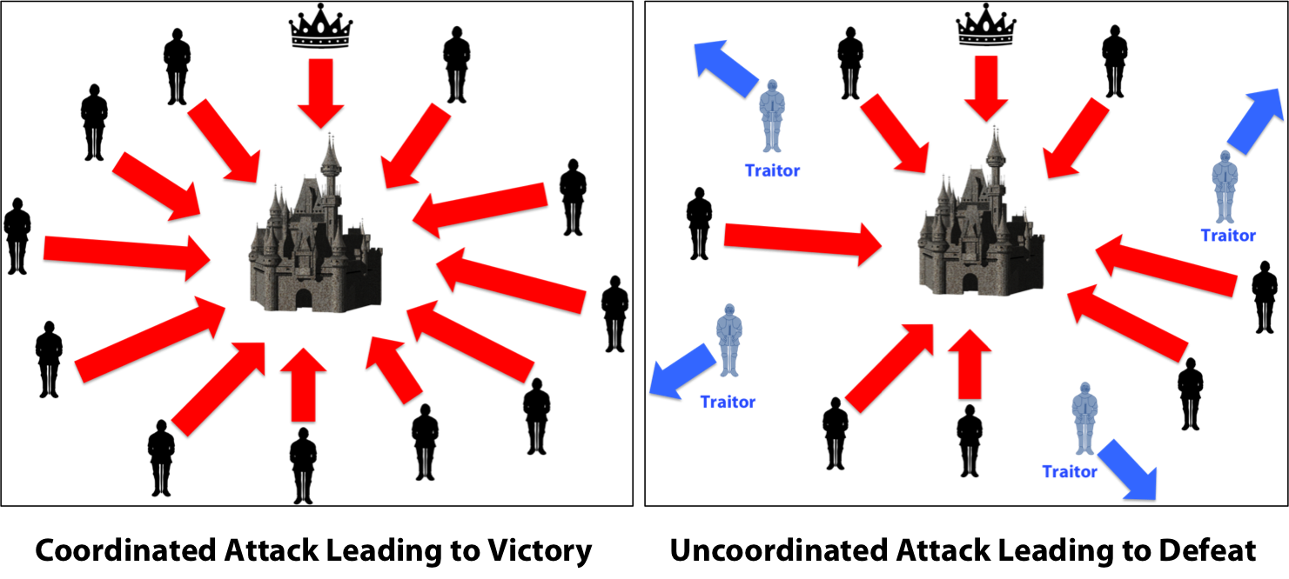
DECENTRALISED CONSENSUS
Byzantine Generals Problem
Let’s expand this further, what if we have many general’s?
What if there are traitors?
There is latency issues between each message pair? Which message was first?
32

Slide 33
DECENTRALISED CONSENSUS
Agreeance on a Protocol …
SOLUTION
General’s haven’t agreed on a plan of attack, but they agree on a protocol to agree upon.
Imagine each general accrues messages into ‘blocks’ instead of reactively replying to each message.
The block data is then used as input into a SHA256 algorithm
For logistical brevity, they want a common state every 10 minutes
The SHA256 algorithm is created difficult enough that each general’s computational power takes on average 10 minutes to find a correct output.
Once this output is verified correct, the prize winner get’s to send their message across the battlefield, and all the generals start “mining” the new block.
If certain general’s disagree with the new block’s messages, then can split the blockchain to their own version of events
“hard fork”
This process is called mining, using the Proof of Work (PoW) consensus mechanism
33

Slide 34
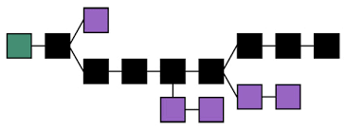
DECENTRALISED CONSENSUS
Traitors/Bad Miners!
Traitorous Plan attempts
But what if there are traitors!?
This process of finding the correct cryptographic solution is inherently random.
Traitors must win the cryptographic puzzle 51% or more of the time consistently to send their traitorous plan across the battle field successfully.
Economically infeasible
They need to maintain their plan, by building new blocks on top of their older ones!
If there are more good general’s then bad, the good generals’ plan of attack will have more mined blocks then with the traitorous plan.
Good Plan
34

Slide 35
BITCOIN: AN INFINITE STATE MACHINE
Coming to a common source of truth
Traitorous Plan attempts
The longest Blockchain is always considered the true record of events, as it demonstrates the chain with the most PoW.
In essence, the Blockchain is a simply a governance model in order to reach a singular state of truth, and acts like a discrete state machine as the truth builds over time!
Good Plan
35

Slide 36
DECENTRALISED CONSENSUS
Reversing back time
Traitorous Plan attempts
What if the traitors want to reverse previously confirmed blocks? (aka a block, 60 blocks deep?)
Must first change the data of the that block
But because the hash of that block is included in the input for the block on top of it, must also redo PoW for that block.
Therefore must mine all 60 blocks above it all while keeping up with the rest generals mining their own Blocks
Impossible!
Good Plan
36

Slide 37
DOUBLE SPENDS
Winding back to Bitcoin
If we wind back our analogy, the incentive for good general’s behaviour is to reach to the common goal of successfully destroying the enemy.
In Bitcoin, the incentive is to earn money from the coinbase transaction!
So what is the analogy for the traitorous general?
Bad miners conducting double spending transactions!
The act of spending a bitcoin twice (or more)!
37

Slide 38
DOUBLE SPENDS
Deception
Balance
0 BTC
DOUBLE SPEND ATTACK
JEFF
Balance
1 BTC
Paul is feeling facetious and wants to do a double spend attack.
Initially, he sends 1 BTC to Jeff in exchange for a lambo, and it get’s accepted onto a Blockchain.
PAUL
Balance
0 BTC
SANDY
38

Slide 39
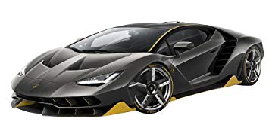
DOUBLE SPENDS
Deception
Balance
1 BTC
JEFF
Balance
0 BTC
PAUL
Balance
0 BTC
SANDY
39

Slide 40
DOUBLE SPENDS
Making friends
Balance
1 BTC
DOUBLE SPEND ATTACK
JEFF
Balance
1 lambo
On his own private Blockchain, he didn’t send 1 btc to Jeff, he sent 1 btc to Sandy, his business co owner.
Colluding with each other, they don’t broadcast their plans, and aim to build then own Blockchain that will be longer the “true Blockchain”.
PAUL
Balance
0 BTC
SANDY
40

Slide 41
DOUBLE SPENDS
Making friends
Balance
0 BTC
JEFF
Balance
1 friend
PAUL
Balance
1 BTC
SANDY
41

Slide 42
DOUBLE SPENDS
A free lambo …
Balance
0 BTC
DOUBLE SPEND ATTACK
JEFF
Balance
1 lambo
Mining ferociously, they manage to get their chain bigger then the main chain.
They then choose to broadcast their chain across the network.
Protocol dictates that the longest chain is the chain with the most PoW. Everyone adopts and agrees Paul payed Sandy 1 btc. As Paul and Sandy use the bitcoin for themselves, Paul effectively just got a free lambo!
PAUL
Balance
1 BTC
SANDY
42

Slide 43
DOUBLE SPENDS
Back to reality
In reality, its computationally infeasible for Paul and Sandy to produce a longer Blockchain.
Bitcoin has never sustained a prolonged 51% attack in almost 10 year history.
“Bitcoin works better in practise then in theory” – anonymous tweeter
43

Slide 44
CONTINUING TO LECTURE 02 ...
Alternate Consensus Protocols
PoW, PoS, dPoS, PoP, PoA etc
On and Off chain scaling
Lightning, Casper, Block size etc
Alternative game theoretics and Governance
44

